Slide 1
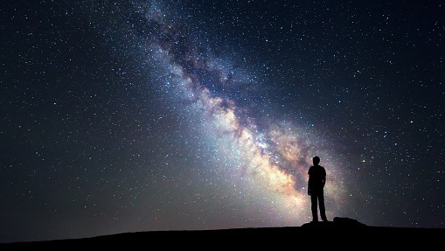
The universe
By Luke Mauger

Slide 2
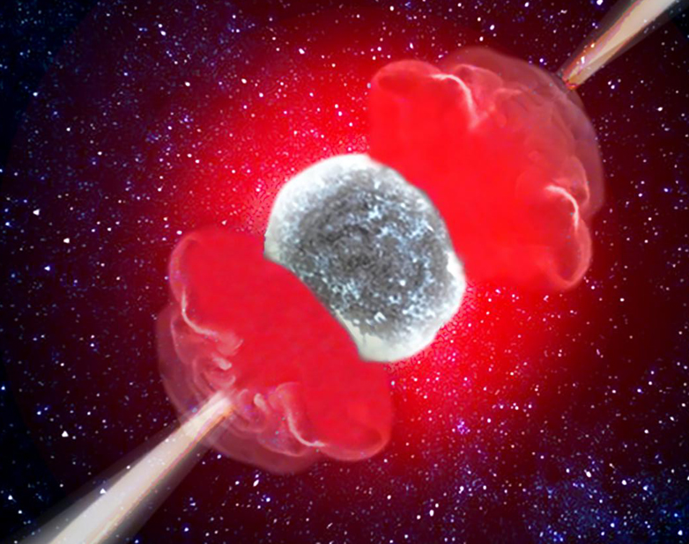
The beginning
13.7 billion years ago
Notes:
The universe began 13.7 billion years ago in the big bang, at the time the universe was hotter and denser than anything we can imagine, when it exploded the universe was created in a fraction of a second from the size of a single atom to the size of a galaxy, it kept expanding getting faster and faster it is still expanding today, scientists still don’t know what makes it expand but astronomers theorize that there is a force that is pulling everything apart.
Overtime The universe was split in three different stages the first stage is the pre compression era the, second era is the compression era, and the third era is the post compression era the three era's were split based on how energy and matter interacted

Slide 3
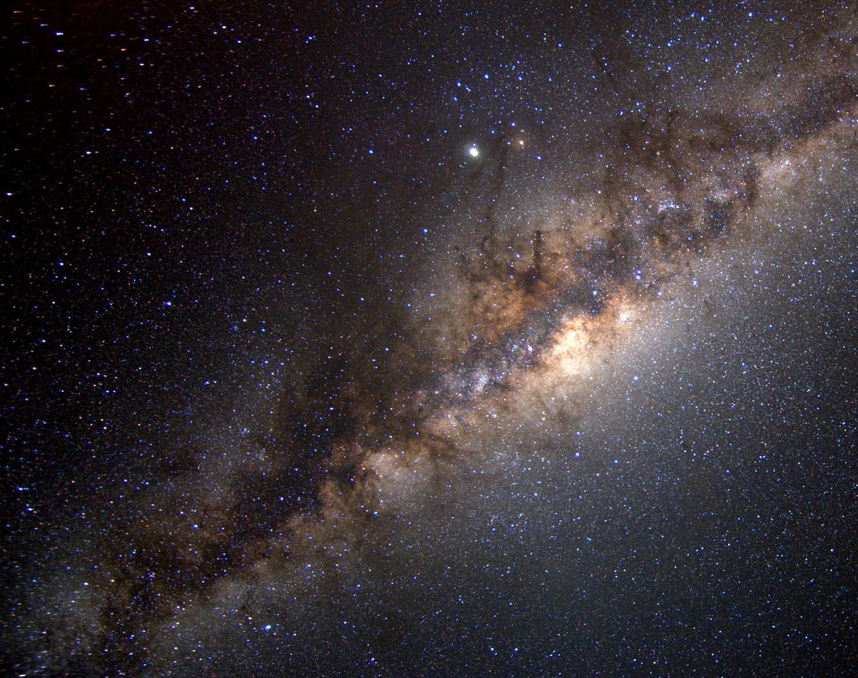
the Milky way Galaxy
The speed of light is 299792458 metres a second
Our galaxy was created 13.51 billion years
When star clusters came together around the supermassive black whole which then flattened into a disk overtime as it rotated faster and faster
Notes:
The galaxy's core lays 26,000 light years away and contains a supermassive black whole, if the voyager were to travel to the centre of the galaxy it would take it 450,000,000 years but if it could travel at light speed it would take 26,000 years but it is impossible due to special relativity.
The Milky way also contains over two hundred billion stars and has enough dust, gas and resources to make billions more.
But The most common stars in the galaxy are red dwarfs, a cool star about a tenth the mass of the sun. Once thought unsuitable for potential life-bearing planets because such bodies would have to be too close to meet the criteria, red dwarfs are now considered potential suspects.
The Milky Way is on track to collide and merge with its nearest neighbour, the Andromeda galaxy, in about 4 billion years. The galaxies will pass through each other, get snapped back together by gravity, and eventually merge cores.

Slide 4
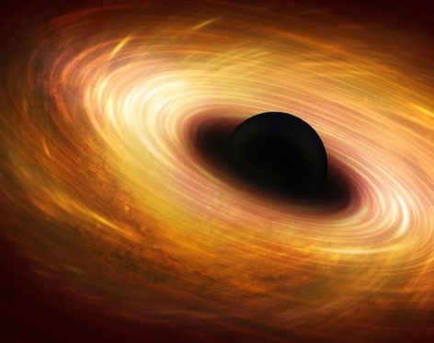
Black holes
There are four types of black holes stellar, intermediate, supermassive and miniature
Notes:
Black wholes are extremely dense points in space that beyond a certain point everything will fall into it and it’s pull is so powerful not even light can escape.
They are created when stars with a certain mass die and explode in a massive explosion known as a supernovae, when it explodes it pushes out its stellar matter out and all that is left is its core, when the star was alive the force that powered it kept it from collapsing in on itself but with all of its fuel gone there is nothing left to power it so it’s core collapses.
Stellar black holes range from five to several tens of solar masses
Supermassive black holes are the largest type of black hole and they have millions to billions times the mass of our sun.
The largest black whole known right now is Abell 85, Abell 85 is roughly the size of our solar system, but packs the mass of 40 billion suns.
Black holes are also invisible because nothing not even light can escape so it can only be detected by its gravitational effects on nearby objects.
What is even weirder as you get closer to a black hole, the flow of time slows down, compared to flow of time far from the black hole. According to Einstein's theory, any massive body, including the Earth, produces this effect. However the Earth's gravity is so weak compared to a black hole that the slowing of time is not noticeable, but the effect has been confirmed using sensitive instruments. For example, at sea level you age one-billionth of a second less every year than you would if you lived on top of Mt. Everest.

Slide 5
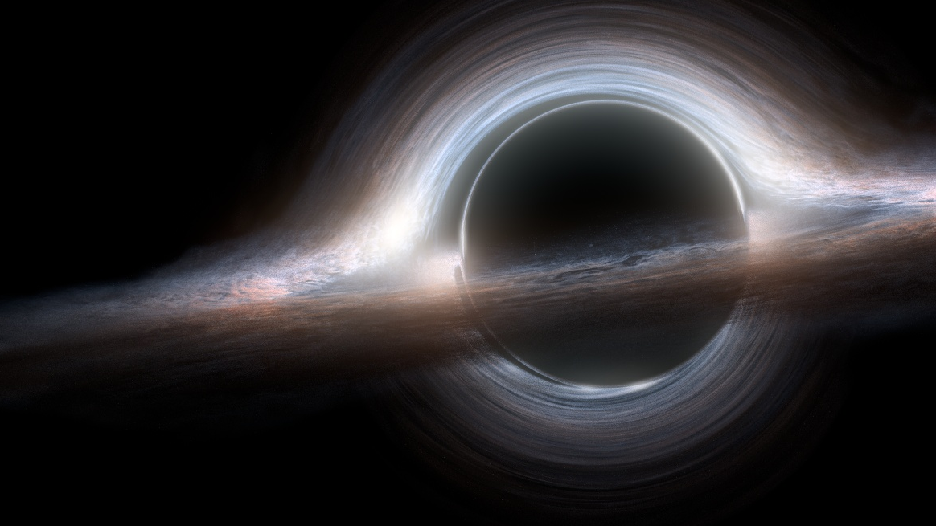
Can black holes die?
4:27-5:27
Notes:
Black holes can die in a process known as evaporation how ever it can take a very long time depending on the mass of the black hole. In 1974, Stephen hawking made one of his most famous predictions that black holes will eventually evaporate and die
According to Hawking’s theory, black holes are not perfectly black and that they emit particles. This radiation, hawking believed could eventually siphon enough energy and mass away from the black whole to make them disappear. This radiation came to be known as Hawking radiation.

Slide 6
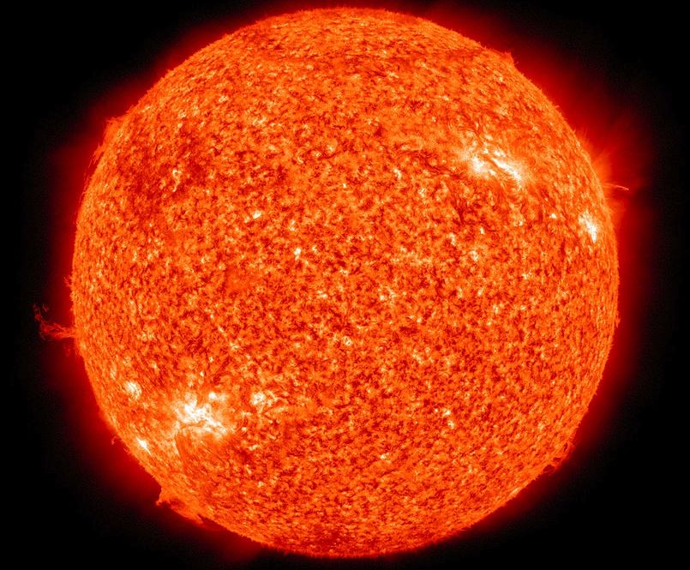
creation of the sun and solar system
The sun was born 4.6 billion years ago
It was formed from a giant gas cloud known a solar nebula
And collapsed because of its gravity, as it spun faster and faster the debris flattened into a disk
forming the solar system
Notes:
The star in the centre of the solar system is a nearly perfect sphere of hot plasma, heated to incandescence by nuclear fusion reactions at its core. so It is a nearly perfect ball of fiery death 865,370 miles in diameter that produces so much power, that every hour it make’s more anergy that we humans make in an entire year.

Slide 7
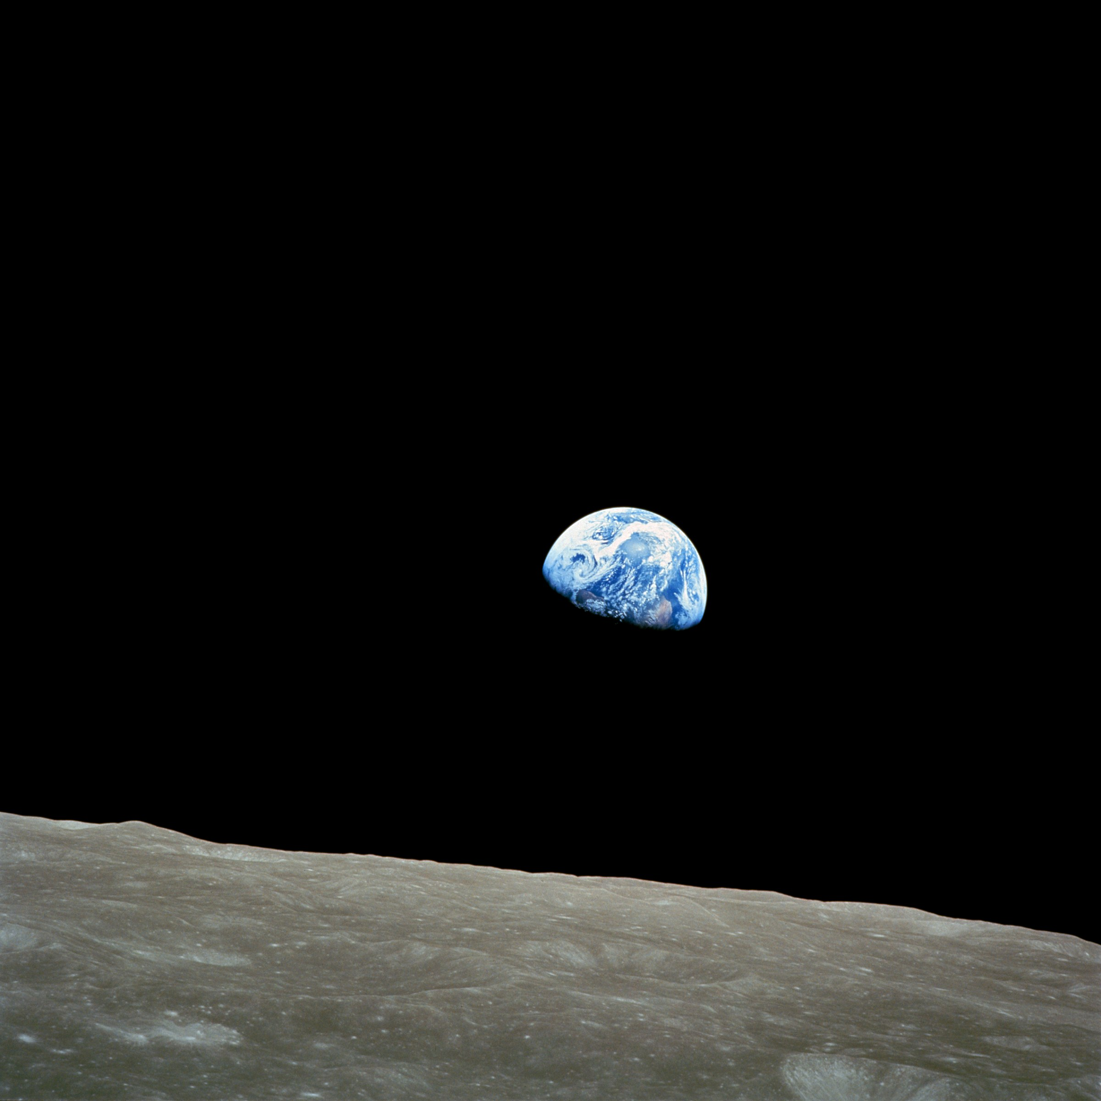
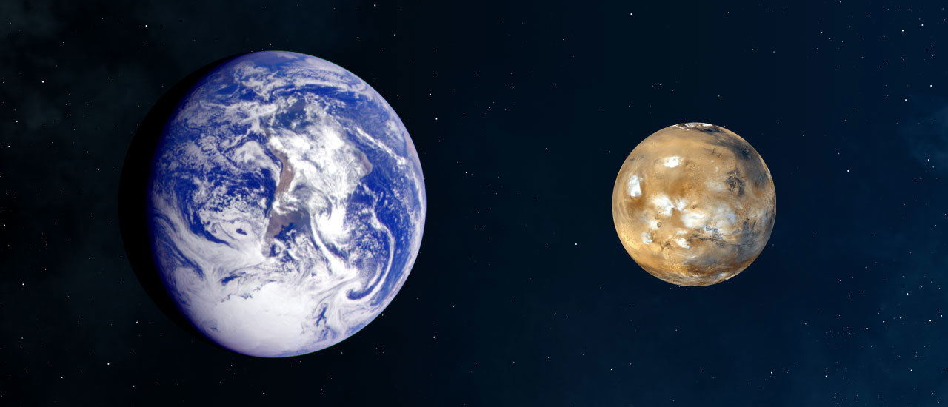
Creation of the earth and moon
Earth and Mars size comparison
As the sun was formed and the solar system started to settle all of the gas and dust built up and started to form the planets
Notes:
The moon was created 4.425billion years ago there are many theories as to how the moon was created but there is one that is most widely accepted is the giant impact theory Which is when the debris of a giant impact between earth and a mars sized planet around 4.5 billion years ago.
Another theory is the fission theory when in the eighteen hundreds George Darwin the son of Charles Darwin suggested that the earth might have spun so fast that a piece of it was torn of and held in place by the Earths gravity.

Slide 8
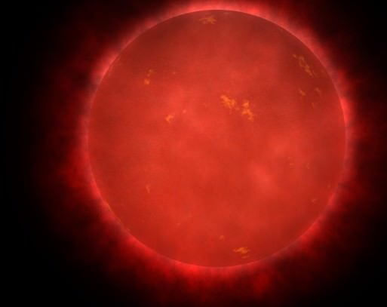
Death of the sun
In about 5 billion years the sun will begin the helium burning process and turn into a red giant
Notes:
When it expands its outer layer will consume the three planets Mercury Venus and maybe Earth when it does the goldilocks zone or the habitable zone will change the goldilocks zone is the space far enough away from the star that it wont fry but close enough to form liquid water when it does change if the Earth does survive its atmosphere and liquid oceans will burn up and all that will be left is molten rock

Slide 9
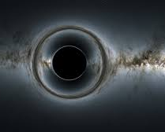
The end of the universe
Notes:
There are many theories about how the universe may end the four big theories are the crunch, rip, freeze or the decay

Slide 10
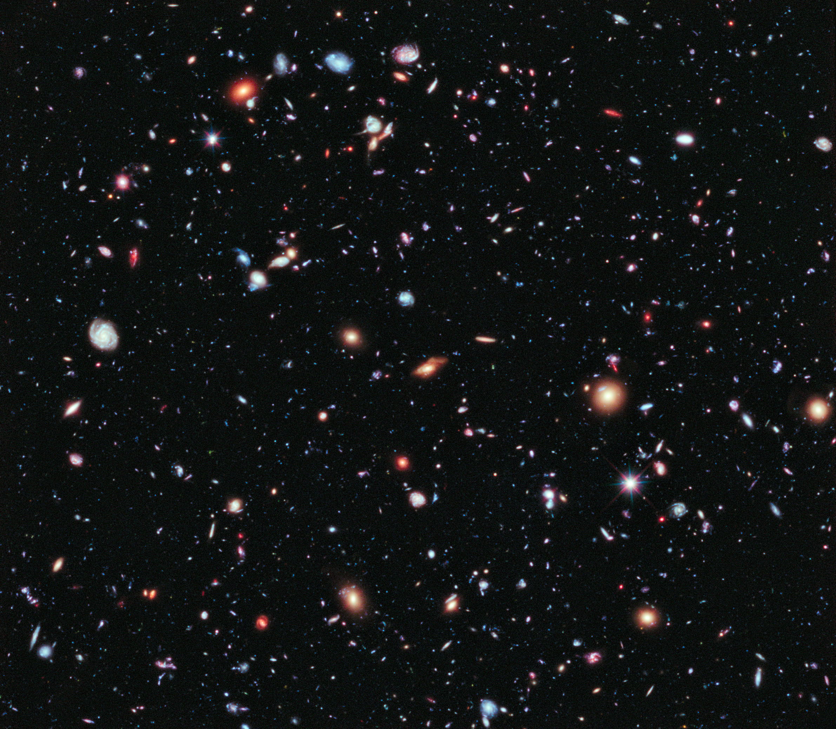
The big crunch
The Big rip
The big freeze
Vacuum decay
Notes:
The Big Crunch is a hypothetical situation for the destiny of the universe, in which the expansion of the universe inverts and the universe collapses, and it could possibly be followed by a rebirth of the universe beginning with another Big Bang.
If the big rip is the way the universe ends then all matter of the universe from stars to galaxies and atoms to subatomic particles will be torn apart by the expansion of the universe. the expansion will also eventually tear apart spacetime itself
If it ends in the big freeze all matter will expand forever until it reaches a final uniform state and as space and matter gets further and further away matter wont clump together and no new stars will be created and the universe will be cold forever
Or it could end in decay or vacuum decay which is when the delicate balance between quantum particles breaks down, the Higgs field would break out of its false vacuum in a domino effect throughout the universe called vacuum decay. A bubble of vacuum decay would spread throughout the universe at the speed of light As it passes through, all matter, the forces of the universe would cease to function as it currently does.

Slide 11
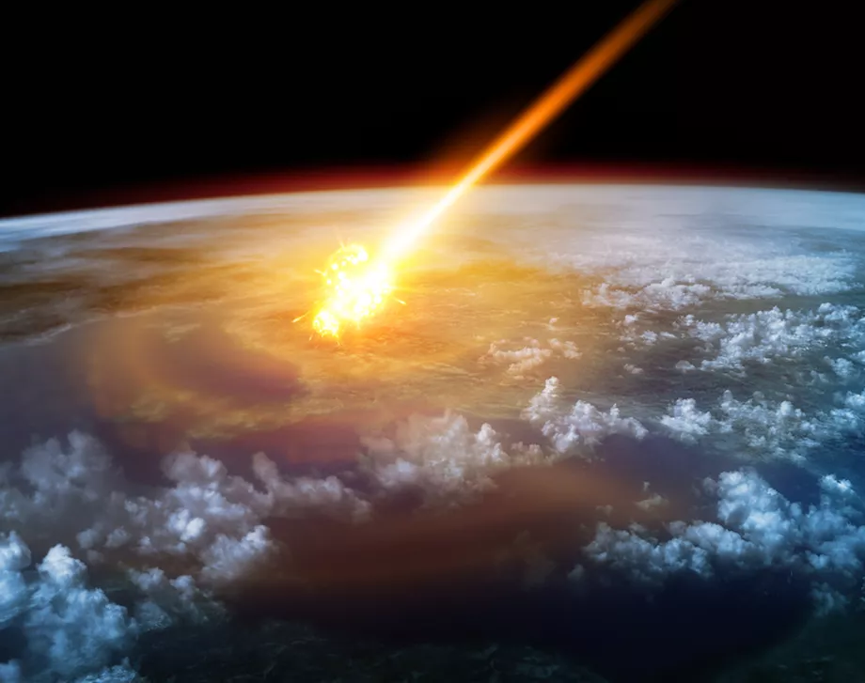
Don’t worry
Large asteroid impact 55-1:55 simulation
These events are so far in the future that its more likely that a comet, asteroid or other cosmic event or something man made will annihilate us before then.
The minimum required asteroid size to wipe out all life is only 60 miles
Notes:
However we can escape this fate if we become a multiplanetary or interstellar species.

Slide 12
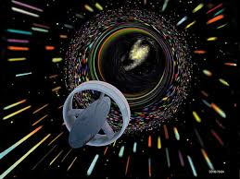
Interstellar travel
Notes:
Interstellar travel is the travel between stars and it is mostly thought to be impossible because the distance between stars is just so vast that our rockets just cant travel them in our lifetimes however, there are multiple ways that have been put forward by scientists witch could move close to the speed of light or perhaps even faster.
Like Nuclear propulsion rockets this method was were a rocket would detonate some type of nuclear bomb from out the back at a certain time for thrust, in the 1950’s/60’s the U.S government codenamed the project , project Orion but because of a nuclear test band treaty the project was closed and made illegal by international law. this is plausible and it could reach around 0.33% the speed of light but it has to be used is space because it comes with a lot of nuclear fallout.
And the warp drive or the Alcubierre drive, this idea was preposed by Miguel Alcubierre in 1994 and the basic idea is that the ship could stretch space in a way that makes the space Infront contract and the space behind expand so rather than trying to get to the speed of light which is impossible the Alcubierre drive would go around it by bending space time. But for now this is purely in the realm of science fiction because it would need enormous amounts of energy to work.
But Both methods would help us travel throughout our entire solar system a lot faster that any methods currently being used.

Slide 13
Copyright
https://www.google.com/url?sa=i&url=https%3A%2F%2Fwww.creambolo.com%2Flibrigialli%2Fis-it-sure-that-black-holes-evaporate%2F&psig=AOvVaw2aYmBTubEB7mpxQmw3JQiq&ust=1606476346672000&source=images&cd=vfe&ved=0CAIQjRxqFwoTCNDGwPGMoO0CFQAAAAAdAAAAABAE
https://www.google.com/imgres?imgurl=https%3A%2F%2Fapod.nasa.gov%2Fapod%2Fimage%2F0801%2F16500feetmilkywaykc2_brunier.jpg&imgrefurl=https%3A%2F%2Fapod.nasa.gov%2Fapod%2Fap080104.html&tbnid=VhXIM0OfH7nDAM&vet=12ahUKEwij_8TRrOvsAhUu2-AKHWCYDP4QMygPegUIARDCAQ..i&docid=NhGei2vlwKgC1M&w=1800&h=1164&q=milky%20way%20galaxy%20band&safe=active&ved=2ahUKEwij_8TRrOvsAhUu2-AKHWCYDP4QMygPegUIARDCAQ
https://www.google.com/url?sa=i&url=http%3A%2F%2Fspaceref.com%2Fastronomy%2Fobservations-of-hypernova-complete-the-picture-of-death-of-massive star.html&psig=AOvVaw3uZjQfdNEipLsVa_1xhioc&ust=1604663767996000&source=images&cd=vfe&ved=0CAIQjRxqFwoTCMDGzsCs6-wCFQAAAAAdAAAAABAP
https://www.google.com/imgres?imgurl=https%3A%2F%2Fscx2.b-cdn.net%2Fgfx%2Fnews%2F2016%2F3-willearthsur.jpg&imgrefurl=https%3A%2F%2Fphys.org%2Fnews%2F2016-05-earth-survive-sun-red-giant.html&tbnid=j_kUD99_nZfYHM&vet=12ahUKEwiG8YHVwo7tAhUEXxoKHa6dBD8QMygGegUIARCuAQ..i&docid=ovIg38X17cmrEM&w=580&h=447&q=sun%20becomes%20red%20giant&safe=active&ved=2ahUKEwiG8YHVwo7tAhUEXxoKHa6dBD8QMygGegUIARCuAQ
https://www.google.com/search?q=black+hole&safe=strict&rlz=1C1GCEB_enGB920GB922&tbm=isch&source=iu&ictx=1&fir=VLuwpfcQcdtj1M%252C6sw08_ffjh6m_M%252C_&vet=1&usg=AI4_-kQWROI8wZiqDXocRld0MTuCAfmuxA&sa=X&ved=2ahUKEwj495bCwo7tAhWConEKHcnlCXsQ_h16BAgSEAc#imgrc=VLuwpfcQcdtj1M
https://www.google.com/url?sa=i&url=https%3A%2F%2Fen.wikipedia.org%2Fwiki%2FCosmology&psig=AOvVaw28acIDDJuDLiDG4-j7iUNG&ust=1606822207150000&source=images&cd=vfe&ved=0CAIQjRxqFwoTCPCpsrGVqu0CFQAAAAAdAAAAABAD
https://www.google.com/url?sa=i&url=https%3A%2F%2Fwww.popularmechanics.com%2Fspace%2Fdeep-space%2Fa31223484%2Fmilky-way-warped%2F&psig=AOvVaw1OnMymFTaT3YJ4BA9M5b8w&ust=1605266998809000&source=images&cd=vfe&ved=0CAIQjRxqFwoTCLiSxtvz_OwCFQAAAAAdAAAAABAE
https://www.google.com/url?sa=i&url=https%3A%2F%2Fwww.spaceanswers.com%2Fdeep-space%2Fhow-many-different-types-of-black-hole-are-there%2F&psig=AOvVaw1co0FsMhl9-PzVhihcnz4e&ust=1606216289455000&source=images&cd=vfe&ved=0CAIQjRxqFwoTCMjKjo_EmO0CFQAAAAAdAAAAABAD
https://www.google.com/imgres?imgurl=https%3A%2F%2Fwww.universetoday.com%2Fwp-content%2Fuploads%2F2015%2F01%2F3_RedNASA.jpg&imgrefurl=https%3A%2F%2Fwww.universetoday.com%2F146981%2F1-in-10-red-giants-are-covered-in-spots-and-they-rotate-surprisingly-quickly%2F&tbnid=1ODcfuixasqL5M&vet=12ahUKEwj2qb-6r5vtAhVRYxoKHcg-DfMQMygCegUIARDQAQ..i&docid=UR2dnfEPyAz0gM&w=1920&h=1483&q=red%20giant%20star&ved=2ahUKEwj2qb-6r5vtAhVRYxoKHcg-DfMQMygCegUIARDQAQ
https://www.google.com/url?sa=i&url=https%3A%2F%2Fwww.theverge.com%2F2016%2F10%2F13%2F13257470%2Fasteroid-comet-earth-impact-global-warming-period&psig=AOvVaw2vxwHMO01W3_by0YPjOtux&ust=1606477967461000&source=images&cd=vfe&ved=0CAIQjRxqFwoTCLiOuvaSoO0CFQAAAAAdAAAAABAE

Slide 14
https://www.google.com/url?sa=i&url=https%3A%2F%2Fwww.wired.co.uk%2Farticle%2Fbig-rip-end-of-the-universe&psig=AOvVaw1LmcFtVtSK-60I2NcDD9Bn&ust=1606825109932000&source=images&cd=vfe&ved=0CAIQjRxqFwoTCNCnpZ-gqu0CFQAAAAAdAAAAABAD
https://youtu.be/bU1QPtOZQZU

